Slide 1
CHPATER SEVEN
Testing

Slide 2
A STRATEGIC APPROACH TO SOFTWARE TESTING
Verification and Validation
Verification: "Are we building the product right?“
Validation: "Are we building the right product?”
Verification refers to the set of activities that ensure that software correctly implements a specific function.
Validation refers to a different set of activities that ensure that the software that has been built is traceable to customer requirements.

Slide 3
A STRATEGIC APPROACH TO SOFTWARE TESTING
Verification and validation includes a wide array of SQA activities
V & V include formal technical reviews, quality and configuration audits, performance monitoring, simulation, feasibility study, documentation review, database review, algorithm analysis, development testing, qualification testing.

Slide 4
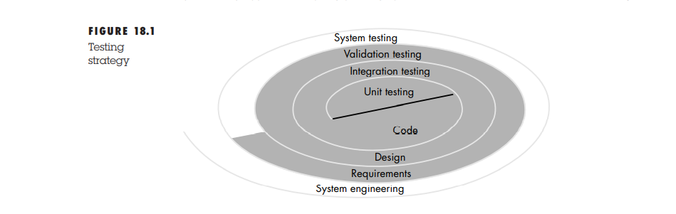
A Software Testing Strategy

Slide 5
A Software Testing Strategy
The software engineering process may be viewed as the spiral
Initially, system engineering defines the role of software and leads to software requirements analysis, where the information domain, function, behavior, performance, constraints, and validation criteria for software are established.
While moving inward along the spiral, we come to design and finally to coding

Slide 6
Unit Testing
Unit testing focuses verification effort on the smallest unit of software design.
Control paths are tested to uncover errors within the boundary of the module

Slide 7
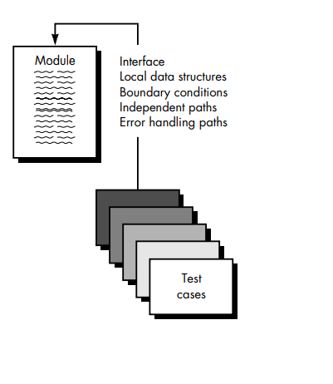
Unit Test Considerations

Slide 8
Unit Test Consideration
The module interface is tested to ensure that information properly flows into and out of the program unit under test.
The local data structure is examined to ensure that data stored temporarily maintains its integrity during all steps in an algorithm's execution.
Boundary conditions are tested to ensure that the module operates properly at boundaries established to limit or restrict processing.
All independent paths (basis paths) through the control structure are exercised to ensure that all statements in a module have been executed at least once.
And finally, all error handling paths are tested

Slide 9
Unit Test Procedure
Unit testing is normally considered as an adjunct to the coding step.
After source level code has been developed, reviewed, and verified for correspondence to component level design, unit test case design begins.

Slide 10
Unit Test Procedure
Driver and/or stub software is developed for each unit test.
In most applications a driver is nothing more than a "main program" that accepts test case data, passes such data to the component (to be tested), and prints relevant results.
A stub or "dummy subprogram" uses the subordinate module's interface.
Stubs serve to replace modules that are subordinate the component to be tested.

Slide 11
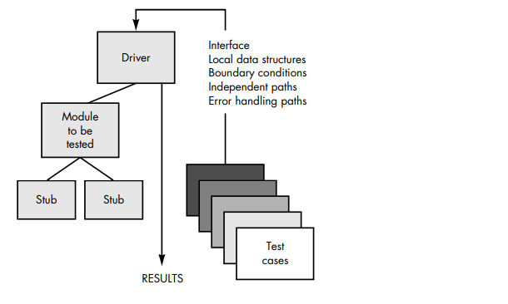
Unit Test Procedure

Slide 12
Integration Testing
If they all work individually, why do you doubt that they'll work when we put them together?"
The problem, of course, is "putting them together"—interfacing
Data can be lost across an interface
one module can have adverse affect on another
sub functions, when combined, may not produce the desired major function
Individually acceptable error may be magnified to unacceptable levels
Global data structures can present problems.

Slide 13
Integration Testing
Non-incremental integration : follow big bang approach → the entire program is tested as a whole.
Incremental Integration :Program is constructed and tested in small increments

Slide 14
Integration Testing
1. Top Down Integration
2. Bottom-Up Integration

Slide 15
Top-Down Integration
Top-down integration testing is an incremental approach to construction of program structure.
Modules are integrated by moving downward through the control hierarchy, beginning with the main control module (main program).
Modules subordinate to the main control module are incorporated into the structure in either a depth-first or breadth-first manner

Slide 16
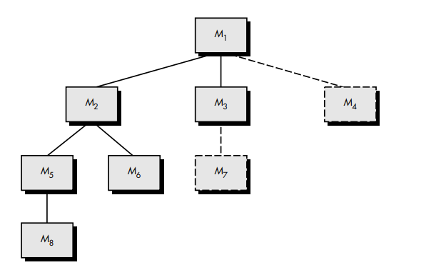
Top-Down Integration

Slide 17
Top-Down Integration
Depth- first Integration – M1, M2, M5, M8
Breath-first Integration –Components M2,M3 and M4 would be integrated first. The next control level M5, M6

Slide 18
Bottom-up Integration
Components are combined to form clusters 1, 2, and 3.
Each of the clusters is tested using a driver (shown as a dashed block). Components in clusters 1 and 2 are subordinate to Ma.
Drivers D1 and D2 are removed and the clusters are interfaced directly to Ma.
Similarly, driver D3 for cluster 3 is removed prior to integration with module Mb. Both Ma and Mb will ultimately be integrated with component Mc, and so forth

Slide 19
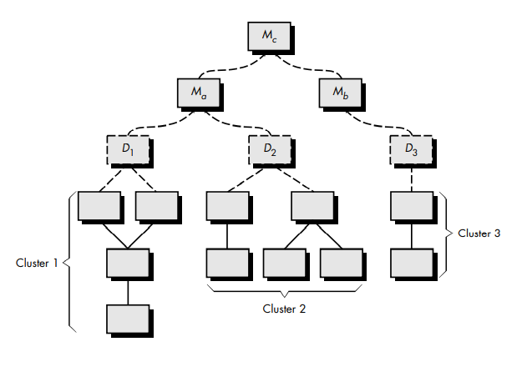
Bottom-up Integration

Slide 20
Regression Testing
Each time a new module is added as part of integration testing, the software changes.
New data flow paths are established, new I/O may occur, and new control logic is invoked.
These changes may cause problems with functions that previously worked flawlessly.
In the context of an integration test strategy, regression testing is the re-execution of some subset of tests that have already been conducted to ensure that changes have not propagated unintended side effects.

Slide 21
Regression Testing
Regression testing may be conducted manually, by re-executing a subset of all test cases or using automated capture/playback tools.
Capture/playback tools enable the software engineer to capture test cases and results for subsequent playback and comparison.
Automatic – Software use
Manual – We manually write the test cases

Slide 22
SMOKE TESTING
Smoke testing is one of the popular software testing services performed after software build to find the functionalities of the program are working fine.
Smoke testing approach encompasses the following activities:
1. Software components that have been translated into code are integrated into a “build.” A build includes all data files, libraries, reusable modules, and engineered components that are required to implement one or more product functions.
2. A series of tests is designed to expose errors
3. The build is integrated with other builds and the entire product (in its current form) is smoke tested daily.

Slide 23
SMOKE TESTING
Smoke testing provides a number of benefits:
Integration risk is minimized
The quality of the end-product is improved
Error diagnosis and correction are simplified
• Progress is easier to assess

Slide 24
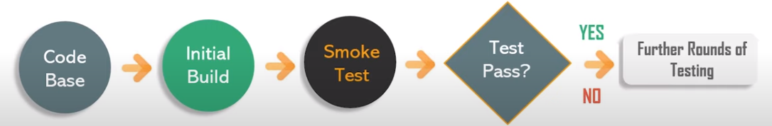
SMOKE TESTING

Slide 25
VALIDATION TESTING
Validation can be defined in many ways, but a simple definition is that validation succeeds when software functions in a manner that can be reasonably expected by the customer

Slide 26
VALIDATION TESTING
After each validation test case has been conducted, one of two possible conditions exist:
(1) The function conform to specification and are accepted
(2) A deviation from specification is uncovered and a deficiency list is created

Slide 27
Configuration Review
An important element of the validation process is a configuration review.
The intent of the review is to ensure that all elements of the software configuration have been properly developed, are cataloged, and have the necessary detail to support phase of the software life cycle.
The configuration review, sometimes called an audit

Slide 28
Alpha and Beta Testing
Alpha Testing
The alpha test is conducted at the developer's site by a developer.
The developers are presented during testing
The developers records the errors and usage problems
Alpha tests are conducted in a controlled environment.

Slide 29
Alpha and Beta Testing
Beta Testing
Conducted at the customer sites by the end users
The customer records all the errors and reports them to the developer at regular intervals
Software is used in an uncontrolled environment.

Slide 30
System Testing
System testing is actually a series of different tests whose primary purpose is to fully exercise the computer-based system.
System Testing
1. Recovering Testing – ()
2.Security Testing—()
3. Stress Testing – ()
4. Performance Testing--- ()

Slide 31
Recovery Testing
Recovery testing is a system test that forces the software to fail in a variety of ways and verifies that recovery is properly performed.
If recovery is automatic re-initialization, data recovery, and restart are evaluated for correctness.
If recovery requires human intervention, the mean-time-to-repair (MTTR) is evaluated to determine whether it is within acceptable limits

Slide 32
Security Testing
Security testing attempts to verify that protection mechanisms built into a system will, in fact, protect it from improper penetration.
During security testing the tester plays the role of hackers

Slide 33
Stress Testing
Stress testing are designed to confront programs with abnormal situation.
Stress testing executes a system in a manner that demands resources in abnormal quantity, frequency or volume
A variation of stress testing is a technique called sensitivity testing.

Slide 34
Performance Testing
Performance testing is designed to test the run-time performance of software within the context of an integrated system.
Performance testing occurs throughout all steps in the testing process.
Even at the unit level, the performance of an individual module may be assessed as white-box tests are conducted.
Performance tests are often coupled with stress testing and usually require both hardware and software instrumentation.

